Slide 1
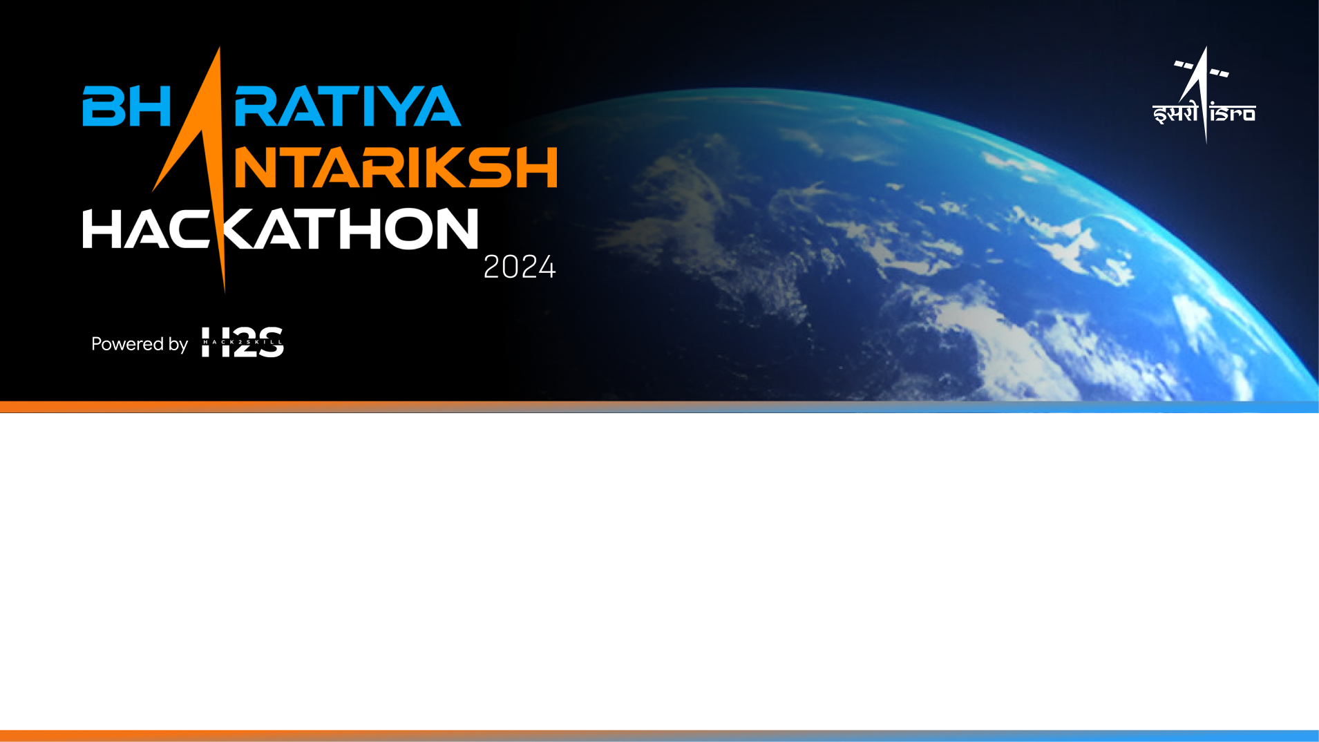
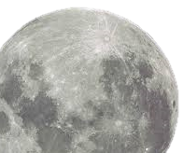
Team Name: Theadvanceais
Name of College(s)/University(s): LJ University
Team Members Details:
Mohit Suthar
Utsav Sehgal
Dhruv Chavda

Slide 2
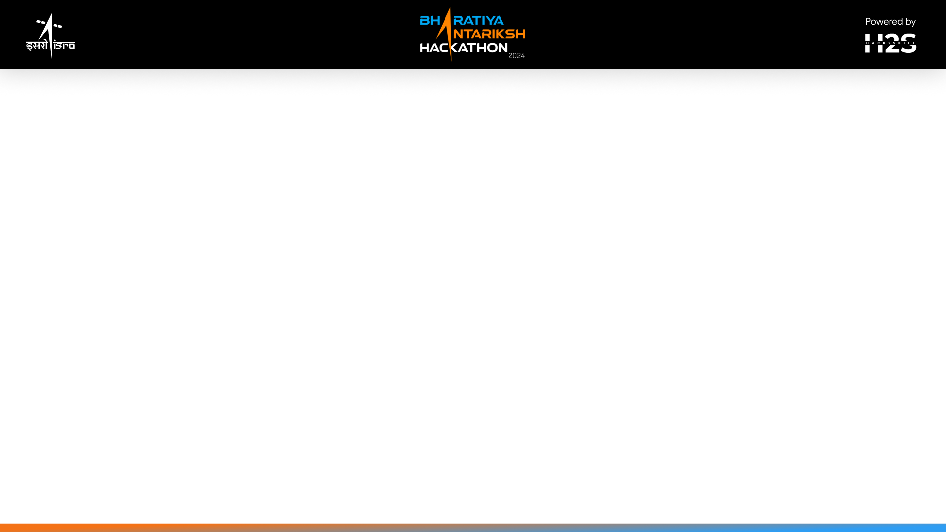
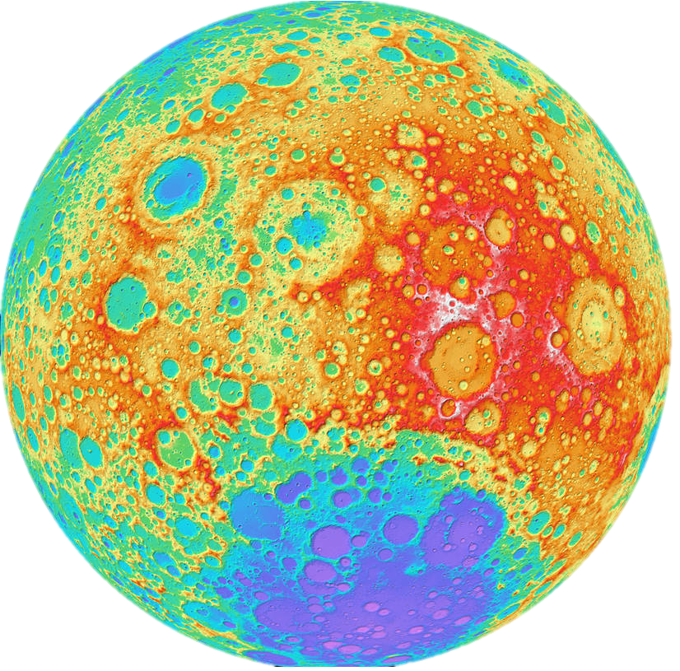
Approach Brief (50 words)
Utilize AI/ML to classify Chandrayaan-2 IIRS hyperspectral data
A user-friendly GUI for data visualization
Apply algorithms to remove noise and classify spectra
Validate results against existing scientific data to aid in lunar geological and mineralogical analysis.

Slide 3
Detailed solution and Approach (250-300 words)
Data Acquisition and Preprocessing:
Download IIRS data from the Indian Space Science Data Center.
Process XML headers to extract crucial metadata like observation angles, exposure, and gain settings.
Convert radiance data to reflectance using equations from the IIRS SIS document.
Clip data to 200 bands for consistency and manageability.
2. GUI Development:
Create an interactive interface displaying IIRS strips on a global Moon background.
Implement functionality to query and display main observational parameters in tabular form.
Enable users to select regions of interest and extract spectral information.
3. Data Classification:
Categorize IIRS strips based on similar spacecraft geometry and acquisition parameters.
Develop algorithms to identify and remove noisy spectra using unsupervised learning techniques like Isolation Forest or Gaussian Mixture Models.

Slide 4
Detailed solution and Approach (250-300 words)
4. AI/ML Spectral Classification:
Applying machine learning algorithms (e.g., K-means clustering, Random Forest) to group normalized spectra into distinct classes.
Implement deep learning models (e.g., Convolutional Neural Networks) for advanced spectral pattern recognition.
5. Validation and Analysis:
Compare our spectral classification results with published scientific outcomes.
Analyze the potential advantages and limitations of using AI/ML for lunar spectral classification.
Interpret results in the context of lunar mineralogy and geology.
6. Optimization and Scaling:
Optimize our algorithms for processing large volumes of hyperspectral data.
Ensuring scalability to handle global lunar datasets.

Slide 5
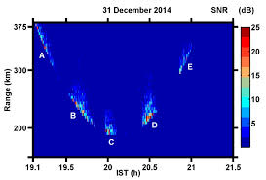
Tools and Technology Used (50 words)
Python for data processing and GUI development.
AI/ML libraries (Scikit-learn, TensorFlow).
MATLAB for spectral analysis.
Visualization tools (Matplotlib).
GIS tools for mapping and visualizing lunar data.

Slide 6
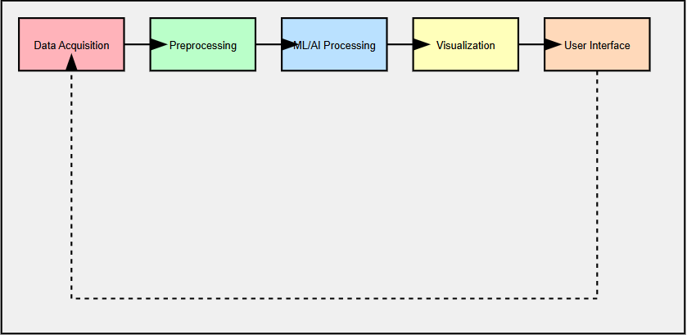
Proposed architecture/user diagram
Data Acquisition : Using highest spectral and spatial resolution hyperspectral data of the Moon from (ISSDC)
Preprocessing : The data will be categorized based on similar spacecraft geometry (observation angle, altitude) to minimize geometry-induced distortions. Python libraries Pandas and NumPy to implement Principle Component Analysis (PCA) and denoising autoencoders for noise reduction.
AI/ML Processing : Support Vector Machines (SVM) and k-means clustering algorithm, will be applied to classify the spectral data into distinct classes with the supporting libraries Scikit-learn and TensorFlow to ensure accurate spectral classification and noise reduction.
Visualization : A GUI will be developed using PyQt. This interface will allow users to visualize IIRS data on a lunar globe with overlays of main observational parameters displayed in a tabular format. Visualization tools like Plotly will be used to create interactive and informative visual representations.
Validation : Results will be validated by comparing them with existing scientific data and published mineralogical maps.

Slide 7
Solution Brief (Overall)
Our solution addresses the challenge of spectral classification of Chandrayaan-2 IIRS data using AI/ML techniques. We've developed a comprehensive system that includes:
A user-friendly GUI for data visualization and interaction.
Robust preprocessing techniques to handle large volumes of hyperspectral data.
Advanced AI/ML algorithms for spectral classification and noise reduction.
Validation methods to ensure accuracy and scientific relevance.
This approach allows for efficient analysis of lunar geological diversity, potentially uncovering new insights about the Moon's composition and history. Our solution is designed to be scalable and adaptable, capable of processing global lunar datasets while providing detailed local analysis.

Slide 11
